Slide 1
MIS3690 Web Technologies
Babson College
TOIM Division
Fall 2015

Slide 2
Understanding variables Manipulating Images Manipulating Styles

Slide 3
Agenda
Understanding variables (Clear and Present Danger)
How to DECLARE (or create) a variable
How to assign values
How to operate with variables
Back to DOM
Understanding the Object
Understanding methods (built-in) functions
Understanding how to manipulate properties through variables
Context
Using ALERT – a built-in function
Manipulating image properties (source, width, height etc.)

Slide 4
Variable in JavaScript
A variable is a temporary holding place for keeping web page elements, their properties, or values.
We create (or declare) variables in JavaScript using
var myForm;
var userChoice;
A variable is valid only within the function where it is created (there are some exceptions – for later…)
Typically, variables make it easy to write functions.
You can assign values to variables:
myColor="red";
You can name a variable anyway you want – just do not use "reserved" words (e.g., don’t name a variable as "form" or "element" or "color")

Slide 5
JavaScript Variables
Variable’s value can change.
Example:
var x;
x=10;
//Some JS statements
x=20;
Variable can be created and given a value in one step.
Example:
var x=10;

Slide 6



Operating on variables
+ Addition
Example:
- Subtraction
Example:
* Multiplication
Example:
/ Division
Example:
++ increment by 1
Example:
-- decrement by 1
Example:
Test them: http://www.w3schools.com/js/js_operators.asp

Slide 7
Key Things to Remember about JavaScript
You must end each JavaScript statement with a semicolon (;) or a new line (or both)
Each statement is either
A JavaScript command (we will learn about these)
Or a JavaScript function (we will learn this too!)

Slide 8
JavaScript Functions
Remember: A function is a set of instructions to the browser to do something
You can create your own functions
We’ll learn the basics
Like the one we just did
Or, you can find functions and "copy" them
Some websites providing free functions, such as http://www.java-scripts.net/
By viewing the source of Web pages that have JavaScript on them
if you don’t understand the function, please do not simply copy and paste.
There are pre-defined functions already available

Slide 9
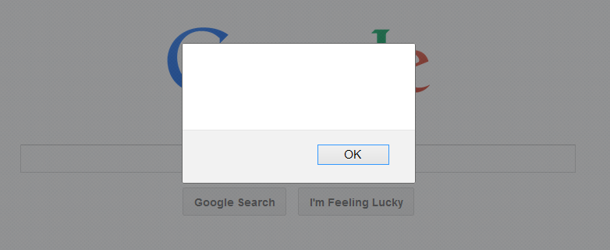
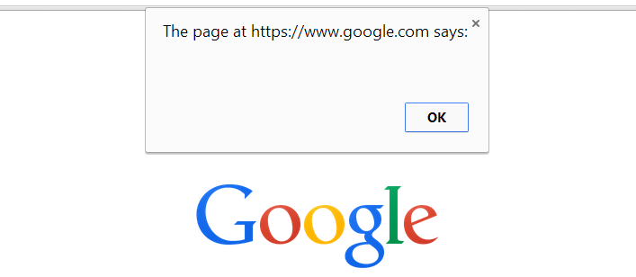
Pre-Defined Functions
Pre-Defined Function Example:
alert() – Pops up an alert box like that shown below
alert (x) – where x is a variable – notice no quotes around x
Will show the alert box with the VALUE that is held in the variable x
Example: alert("My name is Zhi");
Will show the alert with the string "My name is Zhi" displayed as a message.

Slide 10
Writing Your Own Functions
We will typically place all functions in the <head> section
Functions must appear between the two <script> tags <script type="text/javascript">
and
</script>

Slide 11
Format of Functions
function function_name(argument list)
{
Lots of JavaScript statements
}
The argument list is required. It can be
Null or empty – just the parenthesis like ()
A single argument, as for the alert function example
alert (x) or alert ("My name is Jude.")
Several arguments separated by commas

Slide 12
Arithmetic manipulation of variables
x=10;
Assign the value of 10 to variable x
x = x + 10;
Add 10 to the value that is in variable x and store the result in x
var x = 10;
Declare a variable and assign it a value of 10 (both declaration and assignment in the same one step)
x = x*5;
x = x/5;
You can do all this when x stores a numeric value

Slide 13
Variables can also store strings
x = "My name is Zhi"; (note the quote)
Strings are always placed within quotes
y = "Li";
x = x + y;
What will the result of this addition be?
When you have a variable that has a alphanumeric (string) value, when you use the "+" sign to "add" another value, the "+" will concatenate the string with the value. If you use a variable, it will concatenate the string with the value in the variable.
If the variable has a numeric value, the "+" will perform a regular add (mathematical) operation.

Slide 14
As you can see…
When you use + with strings, you "concatenate" strings – i.e., splice strings together!!
When you use + with numbers, it works the way you expect it to – add numbers together!!

Slide 15
CS13-InClass.htm
Use CS13-InClass.htm with the image in it.
We will try and write a function that enlarge the image when you mouse-over the image
Action: define a variable, get the strings of the image into the variable, use the image properties
NEW: JavaScript arithmetic functions: parseInt()

Slide 16
Using variables to manipulate an image
As we said earlier, a variable is a temporary holding device to manipulate objects in JavaScript.
When we write a function to manipulate the height or width of an image, we need to use the built-in function called parseInt().
parseInt()
A built-in function that converts a string (or alphanumerical) into an integer.
To use a math operator (*), you need numeric values.
When using data from a web page, all values are captured as strings (or alphanumerical).

Slide 17
Extending CS13-Inclass.htm
See if you can write the function to enlarge the image (by 50%) when the user moves over on the image.
The event is called onmouseover
Can you define the element?
How do we write the "action" part?

Slide 18
Extending CS13-Inclass.htm
Write another function that will return the image to normal size when you mouse-out of it
The event is called onmouseout
The element is the image.
The action is the complement of what we did to enlarge it.
You need to write a new function (call it whatever you want).

Slide 19
Completing CS13-Inclass.htm
Using the same functions to work with multiple images.
Use of "this.id" parameter
It passes the id of the element within which the call to the function is made
For example:
<img id="one" onclick="enlargeMe(this.id)"……>
<img id="two" onclick="enlargeMe(this.id)"……>
If you click on the first image, the enlargeMe function is called and this.id will have the value of "one", the id of the element within which the function is called.
If you click on image "two", this.id will have the value of "two"!
Save CS13-InClass.htm and FTP it to our server.

Slide 20
Next Class - Look at CONDITIONAL statements
Different ways to write the IF statement
Syntactic requirements for the IF statement
Fun things that you can do if you know the if statement.

